Slide 1

Parcel Group
Emir Açikgöz
George Ottens
Ismail Böyükşimşek
Laurine van de Stolpe
Rick Hagenaar
Idriss Bensaga

Slide 2
What did we do last week?
Improved existing models
  Timeseries train test split
  Removed peeks from timeseries models
Worked on the paper

Slide 3
What we plan on doing?
Working on the paper
Finalizing models

Slide 4
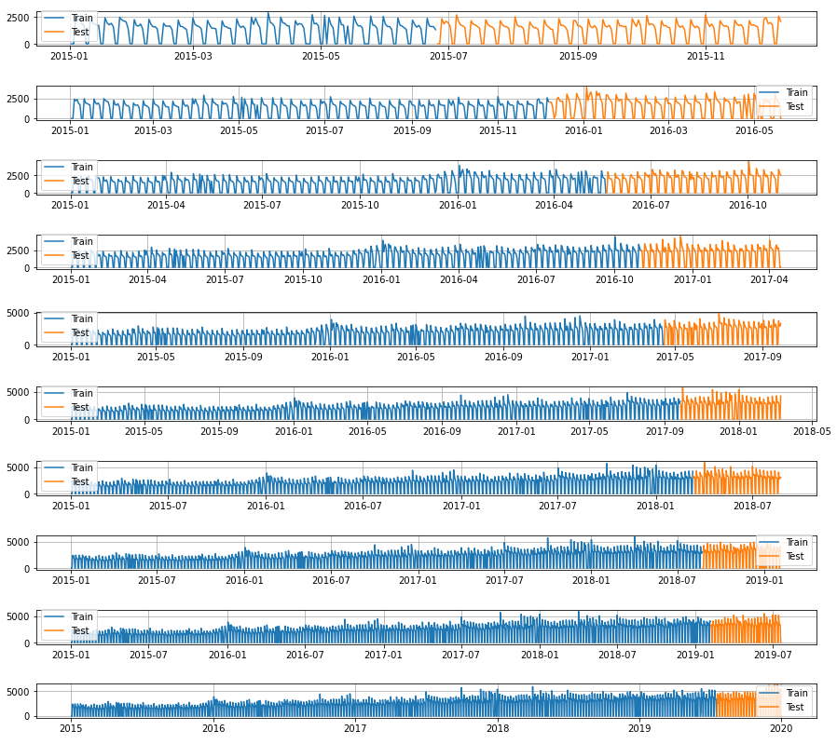
Multiple train test splits
10 splits
Test size stays the same
Train size increases

Slide 5
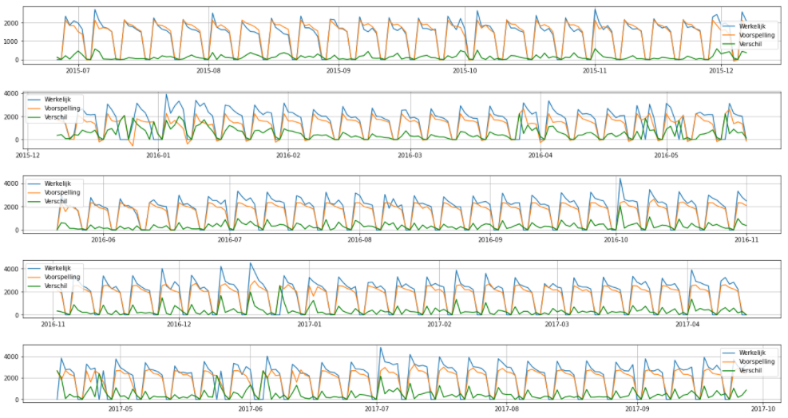
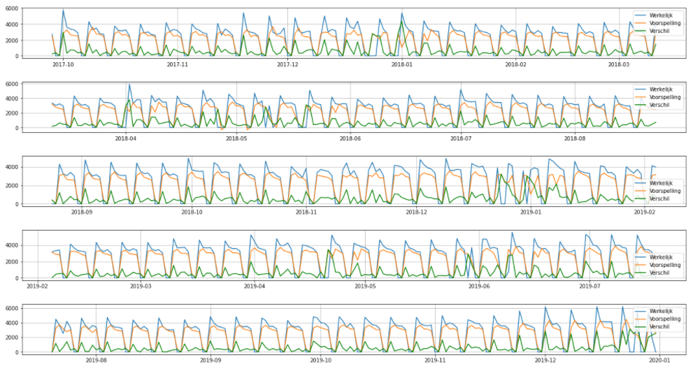
Multiple train test splits
First 5 splits
Last 5 splits

Slide 6
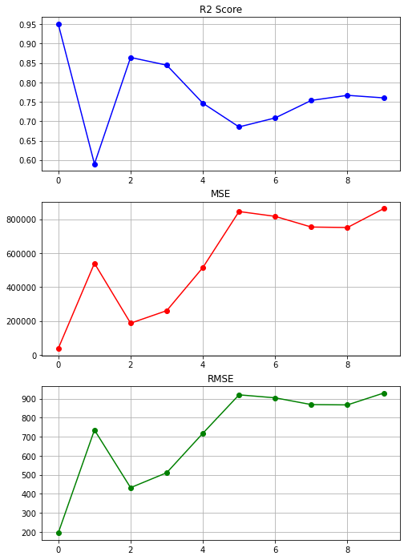
Multiple train test splits

Slide 7
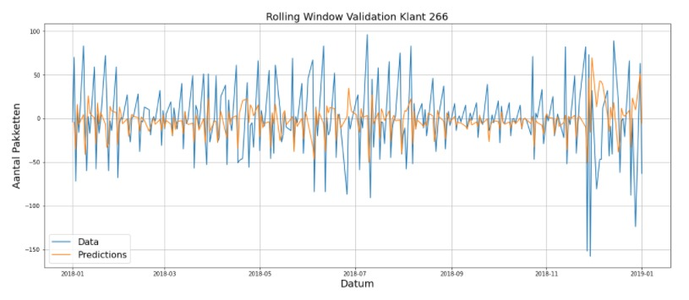
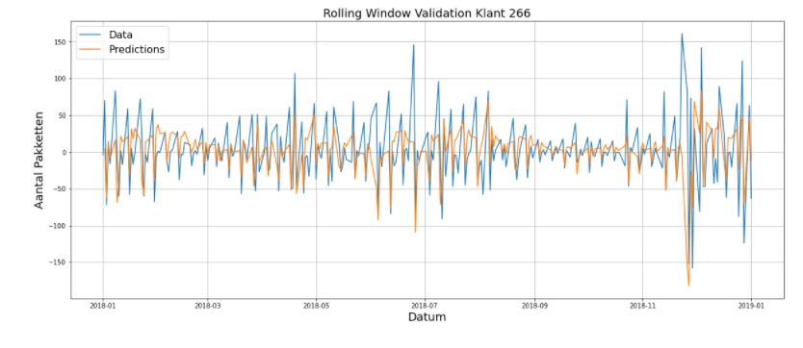
Time series removed peaks
With peaks filtered
No filter

Slide 8
Questions

